Slide 1
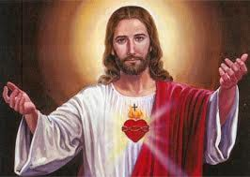
Do Christians believe in the death penalty?

Slide 2
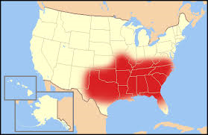
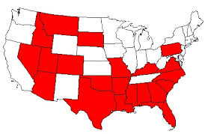
Map of the Bible belt
Map of the states which still use the death penalty.
Look at the two maps above. What conclusions can you draw about Christian attitudes to Capital Punishment from them?
Notes:
Use whiteboards to respond

Slide 3
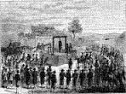
What are the Christian attitudes to capital punishment?
Learning Intention
To decide whether or not the death penalty is compatible with Christian beliefs.

Slide 4
What does the Bible Teach?
Read through the 9 Bible/Church statements and decide whether you think they support or oppose capital punishment.
Stick them into your jotter under the headings “Christian Arguments for” and “Christian argument against”

Slide 5
‘Thou shalt not kill’ Exodus: 21:13 | ‘Whoever sheds the blood of man, by man shall his blood be shed’ Genesis: 9:6 | If a man commits adultery with the wife of his neighbour, both the adulterer and the adulteress shall surely be put to death. Leviticus: 20:10
As the adulteress awaited her punishment Jesus said ‘whoever is free from sin may cast the first stone’. John: 8:7 | If someone has a stubborn and rebellious son who will not obey his father and mother… then all the men in the town shall stone him to death. Deut 21:18-21 | In light of the word of God, and thus of faith, life--all human life--is sacred and untouchable. No matter how heinous the crimes ... [the criminal] does not lose his fundamental right to life, for it is primordial, inviolable, and inalienable, and thus comes under the power of no one whatsoever. Father Gino Concetti, L'Osservatore Romano, 1977
Anyone who curses his father or mother is to be put to death. Exodus:21:17 | David said to Nathan, ‘I have sinned against the Lord’ And Nathan said to David ‘The Lord has put away your sin; you shall not die’ 2 Samuel 12:13 | You have heard that it was said, ‘Eye for eye, and tooth for tooth but I tell you do not resist evil. If anyone strikes your right cheek, turn to offer them also your left. Mathew: 5:38-39
For
For
Against
For
Against
Against
For
Against
Against

Slide 6
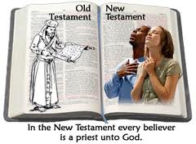
Why the difference of opinion!?!
Within the Christian religion there are divided opinions about capital punishment.
The bibles Old Testament appears to support the use of capital punishment while the teachings of Jesus in the New Testament do not support it.
Read through Christian View information and create table in your jotter
showing the arguments for and against.

Slide 7
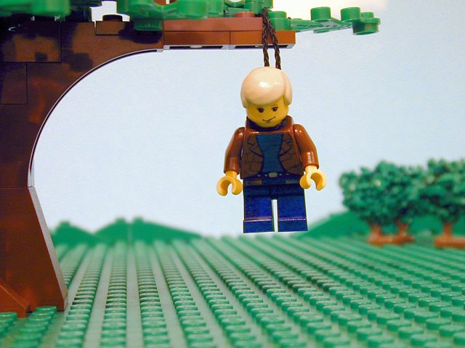
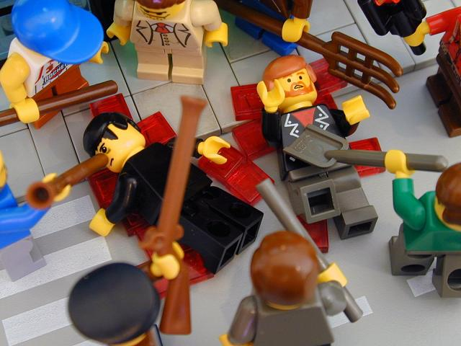
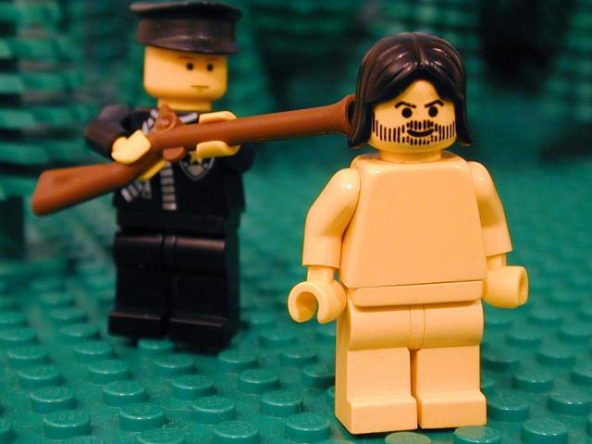
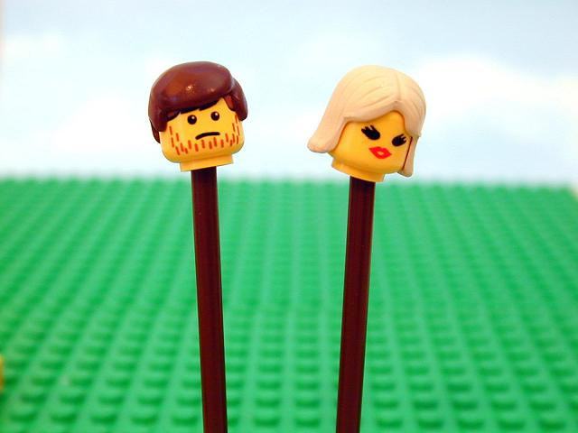
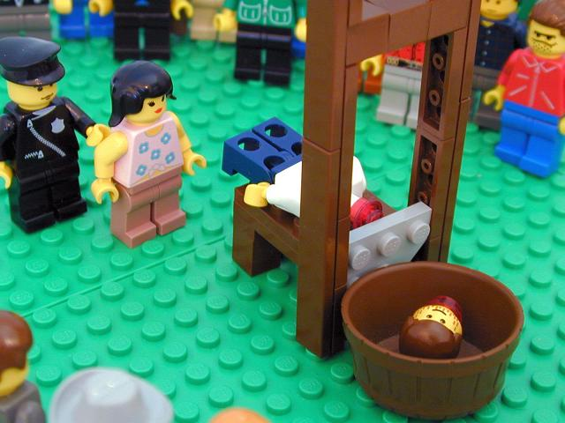
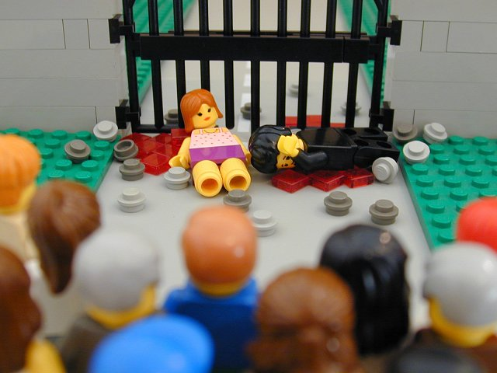
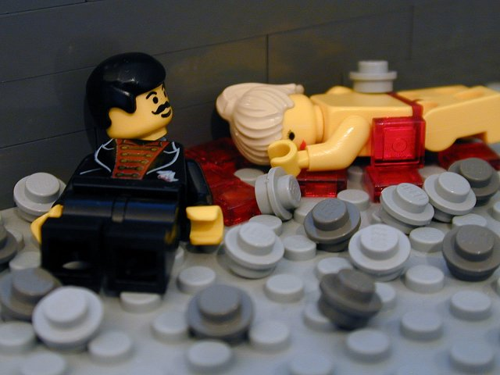
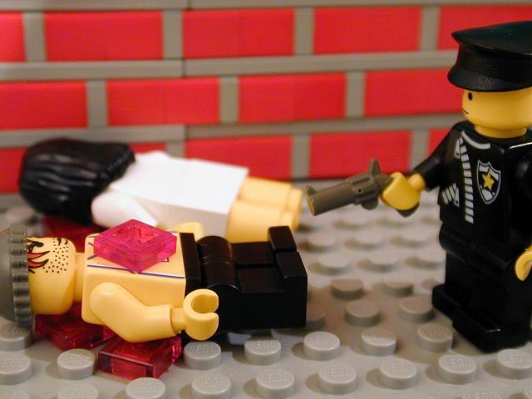
Rape
Homosexuality
Animal Abuse
Adultery
Incest
More Incest
In the old testament there are dozens of crimes for which you can be executed. Some Christians use this fact to support the death penalty.
Adultery
Murder

Slide 8
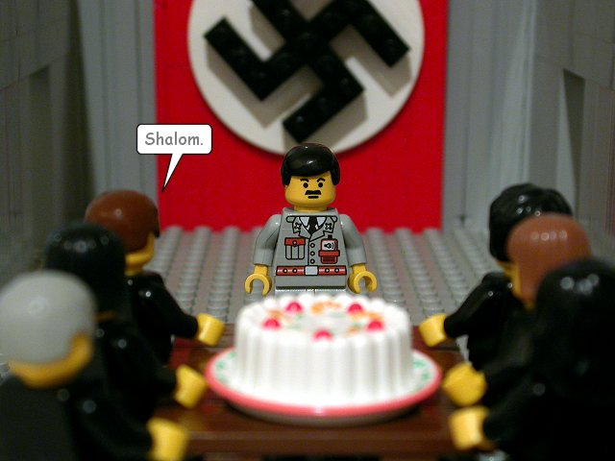
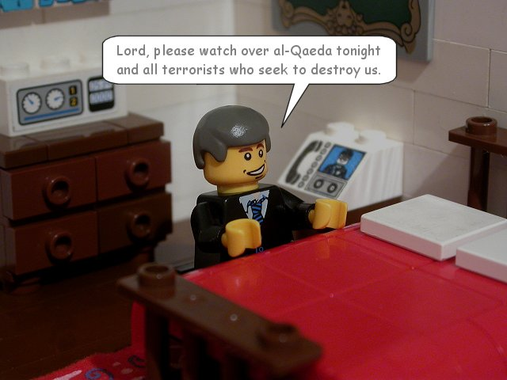
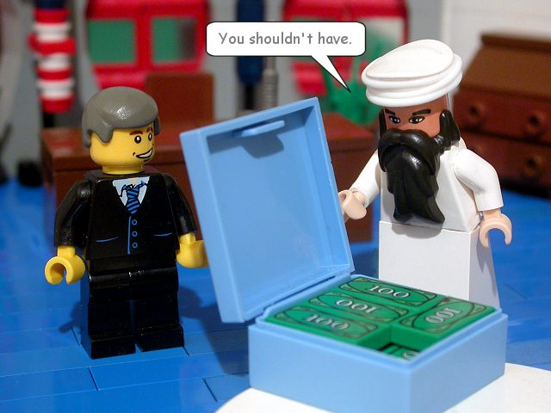
Luke 6:27 'Do good to those who hate you.'
Luke 6:28 'Pray for those who mistreat you.'
In the New testament forgiveness is key. That is not to say that criminals shouldn’t be punished – but when punishing we should be helping them change (reformation) as everyone has the potential for good.
Luke 6:35 'But love your enemies, do good to them, and lend to them without expecting to get anything back.'

Slide 9
Why the difference of opinion!?!
Within the Christian religion there are divided opinions about capital punishment.
The bibles Old Testament appears to support the use of capital punishment while the teachings of Jesus in the New Testament do not support it.
Read through Christian View information and create table in your jotter
showing the arguments for and against.

Slide 10
Different Christian Views
Christian Reasons FOR Capital Punishment | Christian Reasons AGAINST Capital Punishment

Slide 11
Do you think Christians should support the death penalty? (4 Marks)
(National 4)
Explain why Christians disagree over the use of capital punishment (8 Marks)
(National 5)
Tip: You can use page 20 of your
course notes to help you!

Slide 12
4 mark question
I think Christians should/should not support the death penalty.
One reason for this is….
Another reason for this is…
4 mark question
I think Christians should/should not support the death penalty.
One reason for this is….
Another reason for this is…
8 mark question
Christians disagree over the use of the death penalty because…
Jesus taught…
In other parts of the Bible it says…
Finally the Church has used c______ p_____
To punish people who acted against the church therefore…
8 mark question
Christians disagree over the use of the death penalty because…
Jesus taught…
In other parts of the Bible it says…
Finally the Church has used c______ p_____
To punish people who acted against the church therefore…

Slide 13
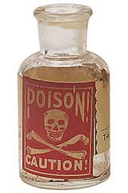
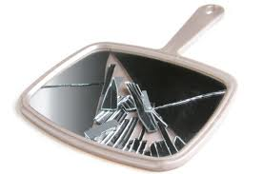
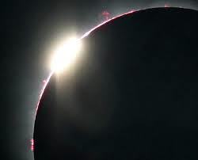
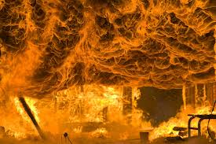
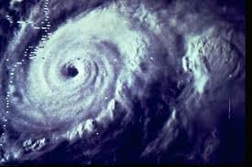
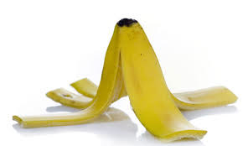
Thinking metaphorically
Some Christians believe that capital punishment is like a ________ because...
For other Christians capital punishment is like a _____ because…
Notes:
Students should use the images to help them create metaphors which summarise the conflicting attitudes to capital punishment in Christianity. They could illustrate their images to break up the endless pages of linear notes!

Slide 15
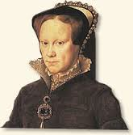
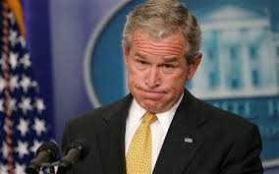
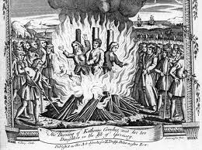
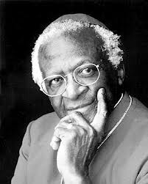
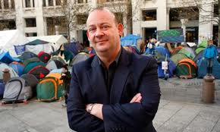
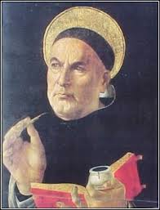
Bush - The Conservative
Mary I
(Bloody Mary)
Rev Giles - The Liberal
Desmond Tutu
Thomas Aquinas

