Slide 1

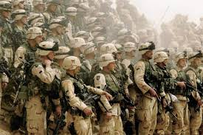


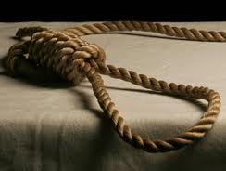

Religion& Justice
National 4/5 RMPS Unit 2
C/W Wednesday, 13 November 2013

Slide 2
Religion, Peace & Justice
Skill | Coverage
Explain different views on moral decision making | Utilitarianism Divine Command/Religious Authority
Apply views to different content | Purpose of punishment i.e revenge or forgiveness Capital Punishment Sentencing in the UK
Analysis | Arguments for/against capital punishment Strengths & Weaknesses of UK sentences Re-offending rates – reasons for Public confidence in UK system

Slide 3
Philosophy & Morality
Learning Intentions
Understand the role of philosophy in the world.
Explain key terms associated with morality.
Reflect on and explain your own views of punishment
Success
Morality section completed in folders.

Slide 4
What is philosophy?
Does the chair you are sitting on exist when we are not looking at it?
If a tree falls in the forest with no one around does it make a noise?
Philosophy is rather like one big debate (argument)
You are questioning the things that we do not know for sure
It can be about really serious stuff- or just be used to blow your mind!!!
Would green still be green if we didn’t call it green?

Slide 5
Important Questions philosophers ask
How should we behave?
How can we determine what is right and what is wrong?
Does religion provide us with morality
Would we be able to behave in the right way if we didn’t have religion?
Why do we punish people?
COPY

Slide 6
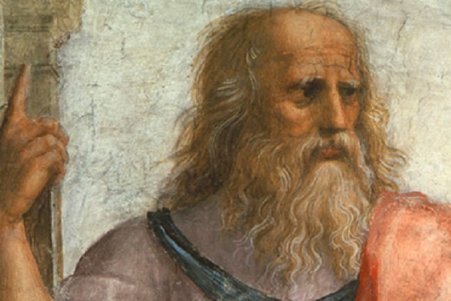
Painting of Plato
(Camera Phones didn’t exist in 427BCE!!!)

Slide 7
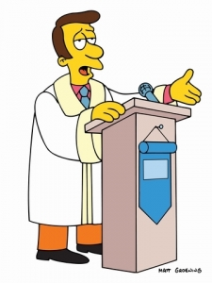
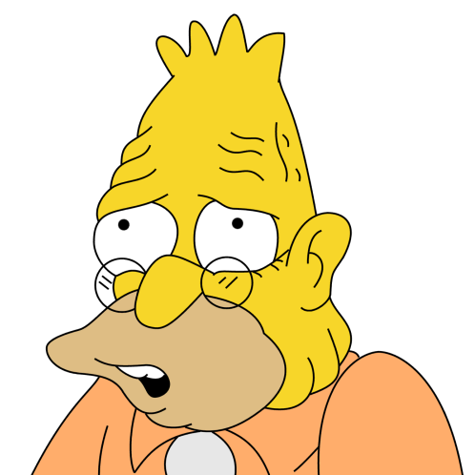
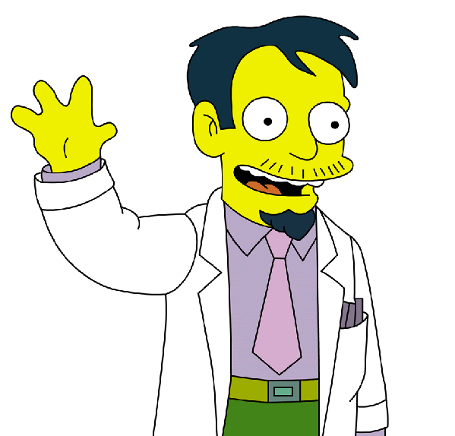

Theories of Punishment
An eye for an eye, a tooth for a tooth!!
I just want the punishment to make the greater number of people happy!
It should benefit society
Turn the other cheek
What do these people think punishment is for?
PTO

Slide 8

Morality
Morality is your sense of right and wrong and moral decisions are based on right or wrong actions.
Which one is a moral decision and why?
a)Deciding where to go on Friday night
b) Deciding whether to steal.

Slide 9
Morality
Terms you must know!
Morality
Moral Values
Moral Actions
Immoral actions
Ethics

Slide 10
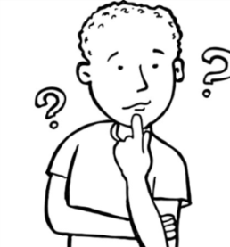
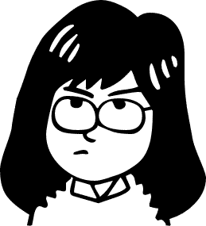
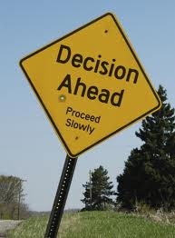
What is your morality? How do you decide what is right and wrong to do ? Ask your partner the questions, and for what reason (see green box). Note down their answers. Eg: 1 = Yes, D
Why did you give that answer?
Because you just want to do the right thing
Because you want to be a good person
Because you want to do what God would want
Because you do whatever has the best result, (consequences) for you or the other person.
Because you only want pleasure for yourself, and don’t care too much about others or doing the right thing
Questions to ask your partner:
Would you give some of your left-over lunch money to a beggar or not? Why did you give that answer? (A-E)
Would you help a friend in her homework, even if you want to go out and play ? Why did you give that answer? (A-E)
Would you hand in a purse with all the £20 notes in it, but only if you get a good reward? Why did you give that answer? (A-E)
Would you own up to breaking your Mum or Dad’s favourite mug, even if they get angry? Why did you give that answer? (A-E)
Would you stay in and finish your project, or go out anyway? Why did you give that answer? (A-E)
Would you tell the truth, but only if it will not get you into trouble.? Why did you give that answer? (A-E)
1. Think about which reason A-E you picked most. That shows you why you mostly do good things – it is your morality.
2. In your book explain what morality you usually follow. Give examples. Eg I usually do things because...… Example: if I found a purse with £20, I would…because… I also do things because ..
**Can you change your morality from day to day?

Slide 11

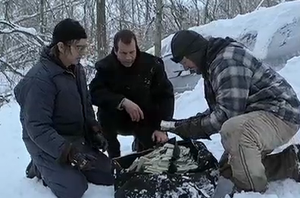
Which morality ?
1. Explain what moralities the characters were using to work out what to do.
2. Whose morality do you agree with most? Why?
Watch the clip.
Which of the men, is using which kind of morality?
Hank
Bob
because it is right to do that
because that is what God wants
Because they are calculating how much benefit it would bring
because it is important to be a good person

Slide 12
Period 2
Instructions
Read through Page 2 of your National Booklet
Complete questions 1-6 in as much detail as possible.
REMEMBER – THIS IS NOT CORE RME, THIS IS NATIONAL 4/5 RMPS AND YOUR ANSWERS SHOULD REFLECT THE LEVEL WE ARE WORKING AT!!!

Slide 13
Religion & Justice
One thing I
already knew about Religion & Justice
Two questions about Religion & Justice
I would still like answered
Three things about Religion & Justice I have learnt in this lesson

